Slide 1
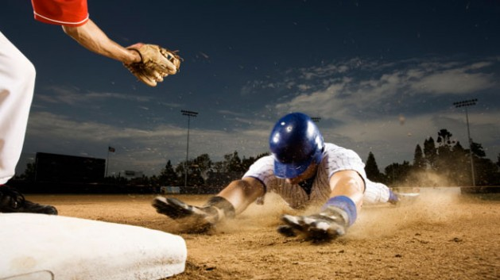
Stealing Bases
Presented by:
Mireille Nehme
Nathalie ouellette
Samuel van noppen
Wyatt Baldwin

Slide 2
Content
BAseball Overview
Goal
Data
Technologies & tools
Analysis
Results
Future analysis
https://www.stack.com/a/base-stealing/

Slide 3
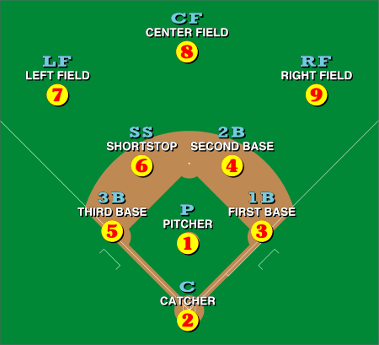
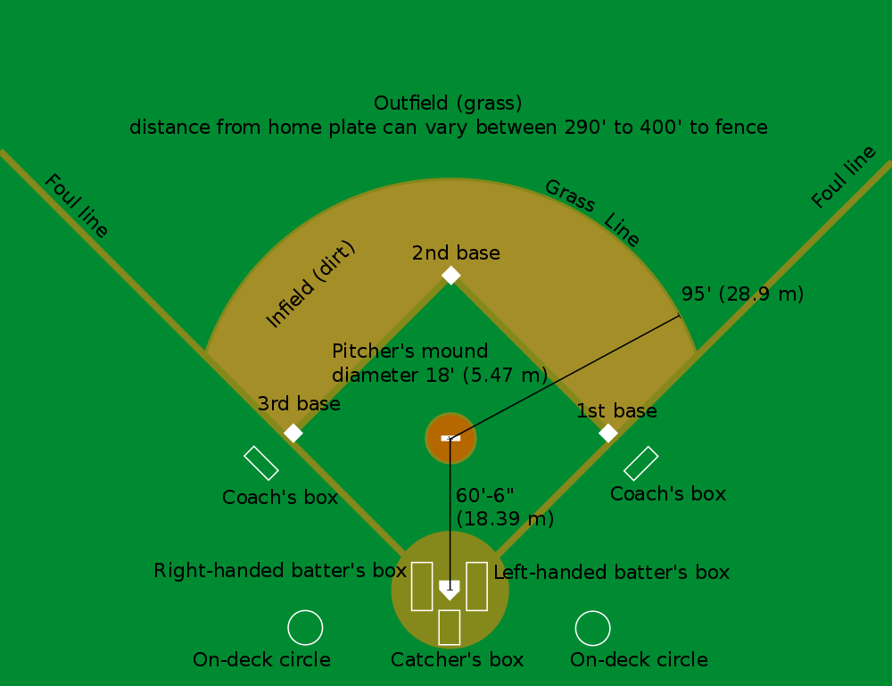
Baseball overview
https://en.wikipedia.org/wiki/Baseball_field
1st strike, 2nd strike, 3rd strike
And you’re out !!
Notes:
9 players per team

Slide 4

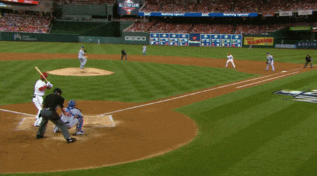
Stealing Bases
1
3
https://gfycat.com/gleamingickyhorsemouse
2
Notes:
9 players per team

Slide 5
Goal
Build a machine learning model to predict whether an MLB runner will be able to successfully steal a base.
Predict next WAR number for pitchers.
Predict next WAR number for batters.
Visualize previous baseball games.

Slide 6
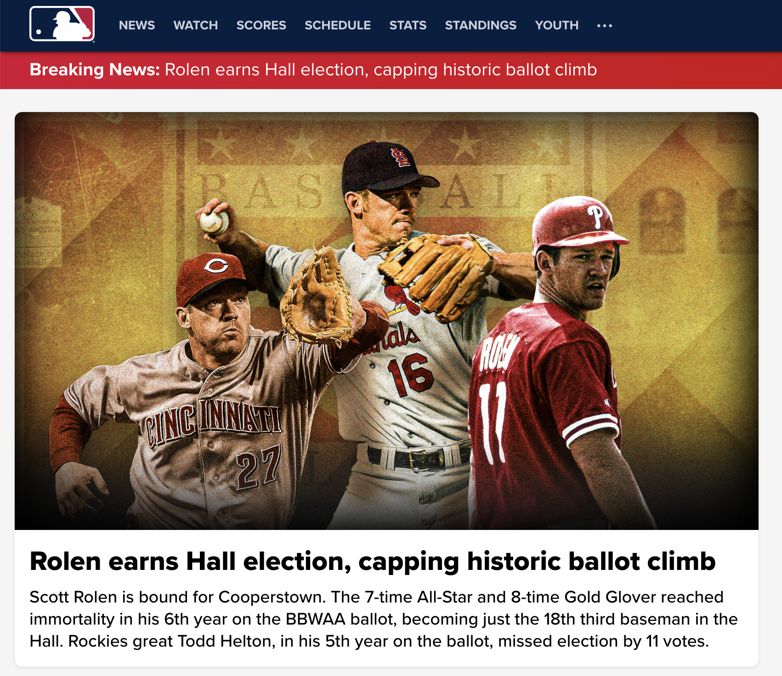
Data
Data source: pybaseball
It is a Python package for baseball data analysis.
from pybaseball import batting_stats
from pybaseball import pitching_stats
from pybaseball import schedule_and_record

Slide 7
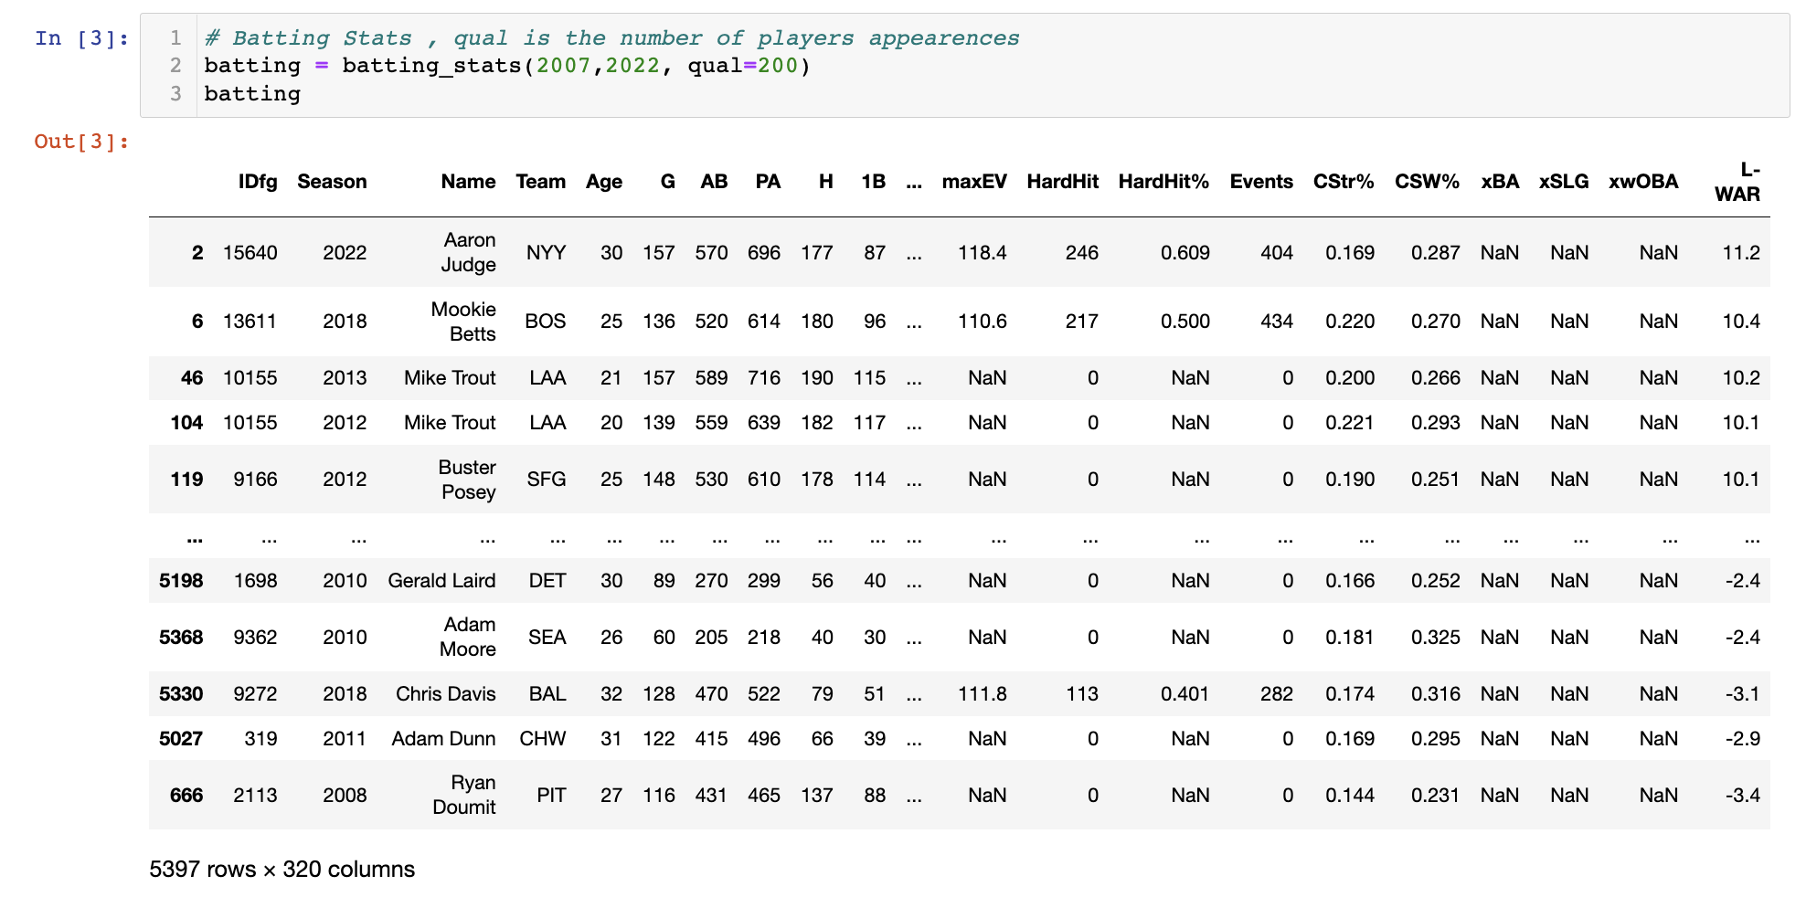
Data – 1st Dataset
Batters Stats

Slide 8
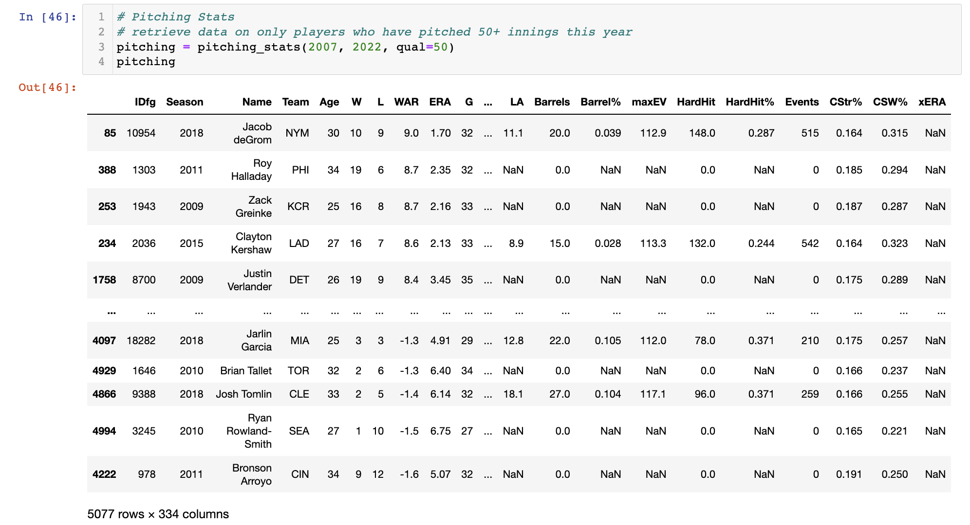
Data – 2nd Dataset
Pitchers Stats

Slide 9
Data – 3rd Dataset
Schedule and record table

Slide 10
Data
Data description

Slide 11
Analysis

